Slide 1




WELCOME TO EYFS AT BAWDSEY

Slide 2





What is the EYFS?
Birth to Five
7 Areas of Learning
5 Key Priciples
The Early Years Foundation Stage is framework that sets the standards for the learning, development, and care of children from birth to age five in England.
•Communication and Language
•Personal, Social and Emotional Development
•Physical Development
•Literacy
•Mathematics
•Understanding the World
Expressive Arts and Design
•A Unique Child
•Positive Relationships
•Enabling Environments
•Learning and Development
•Personal, Social and Emotional Development

Slide 3

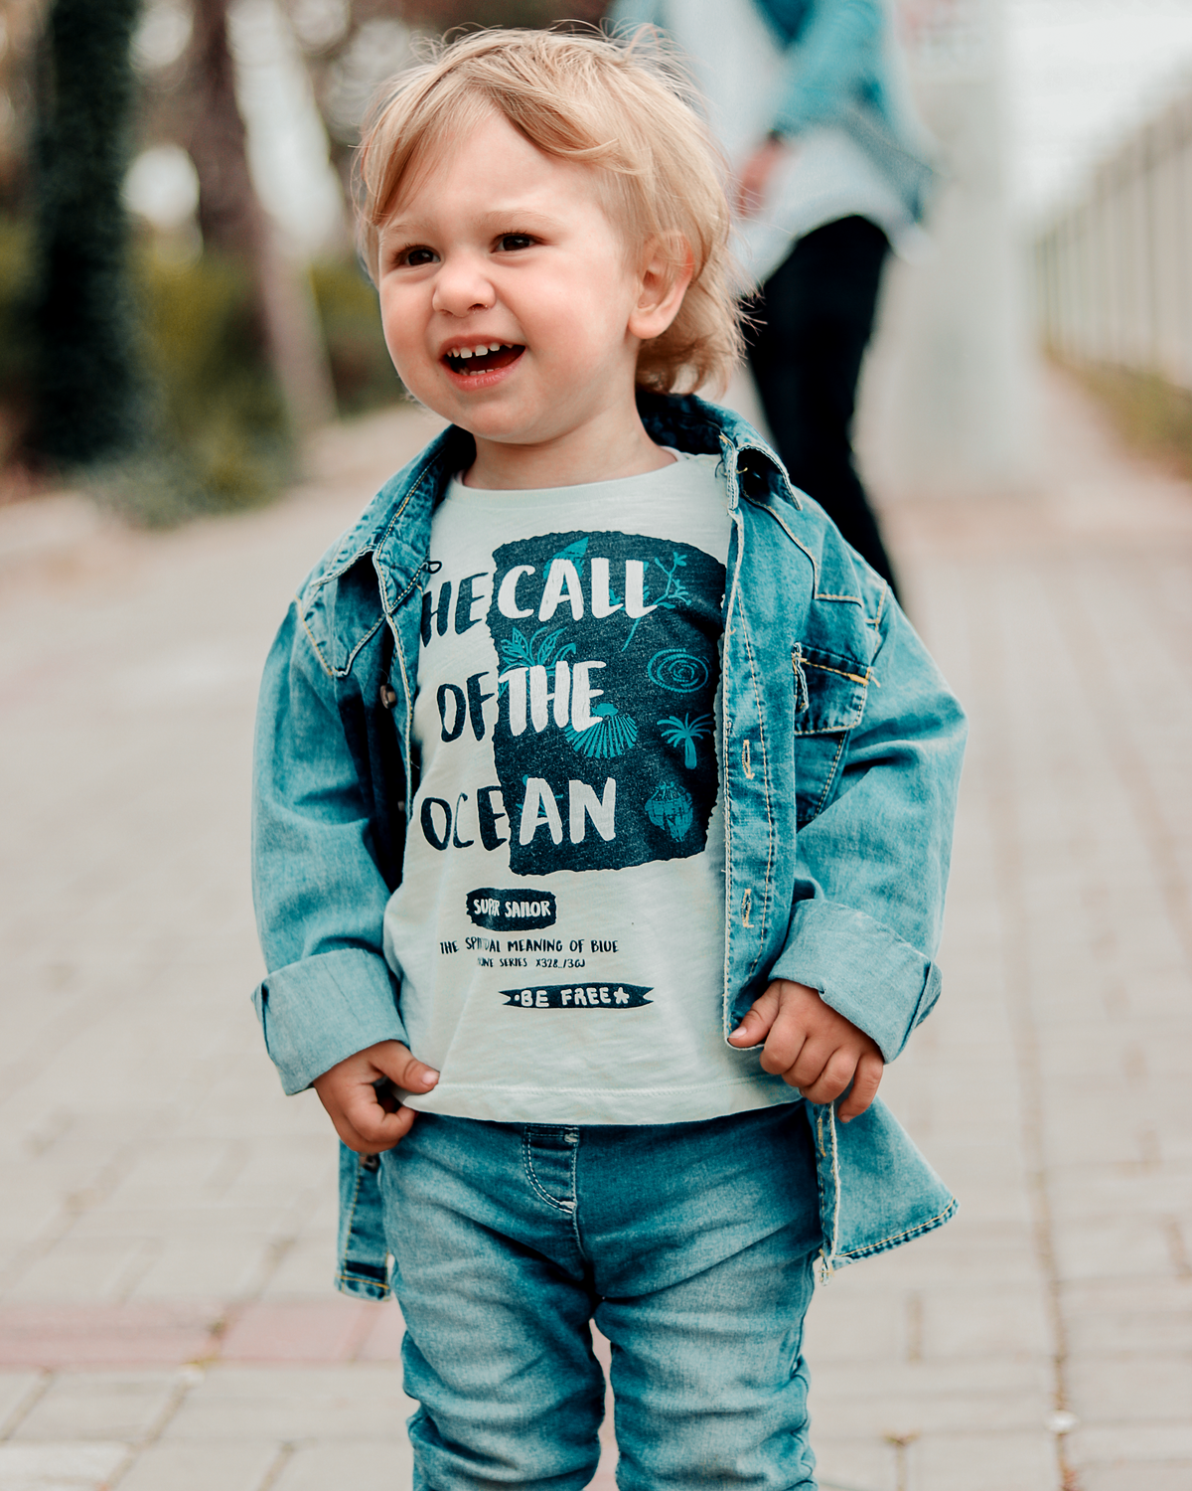


Your child’s Reception year
Small steps
  Gentle transition
  Getting to know your child
  Gradually introducing more structured routines and increase children’s opportunities to be part of the wider school community.
Play
Play is a vital part of learning in Reception.
We offer children a combination of free play and adult led play opportunities, planned to support specific learning needs.
Adult-led Learning
A greater focus on early reading, writing, and maths.
Lessons are short, engaging and supportive. Children are given lots of opportunities to practice their growing skills through play and adult guided activities.

Slide 4
The daily routine
Gates open at 08:40 - 08:50
Morning 1
Lunch time
Afternoon
Register
Choose lunch
Phonics
Maths
Literacy
‘Choosing time’
Whole school assembly
Playtime
Wider curriculum subjects
Forest School
Beach School
Reading
Notes:
Each adult led session is short and highly interactive. Children are all actively involved in the lessons.
Choosing time- As far as the children are concerned this is play! In fact, this is an opportunity to put into practice and build upon the skills and knowledge the children have learnt. Research has shown that play quite literally builds brains, so this is a crucial part of your child's reception year.
Assembly- different themes throughout the week. children are always supported by myself or one of the EYFS team, children quickly feel part of the wider school community.
Playtime- Initially this is in our Nursery garden. Once children are ready they will go out onto the 'big' playground with the rest of the school. Child led.
Lunchtime- All children eat in the school hall, supported by a member of the EYFS team.
School lunch/packed lunch from home. Really helpful if you can tell your child if they are having a school lunch and help them to make a choice from the menu.
Playtime- Nursery garden, then big playground.
Opportunity to choose a library book.
Forest school in Autumn 2 and Summer 2. Beach school in Summer 1.

Slide 5
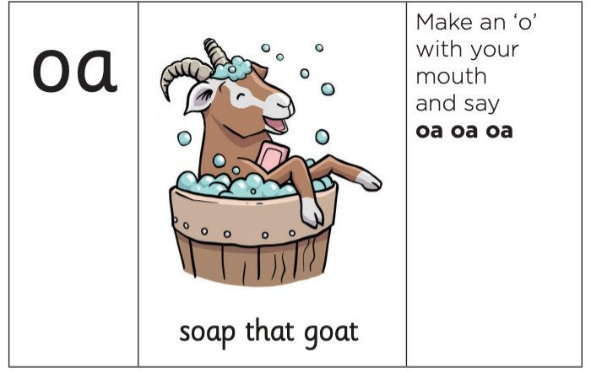
Phonics
•Phonics is the most effective way of teaching children to read.
•Children learn the sounds each individual letter makes.
•Then the sounds that different combinations of letters make.
•This enables them to decode (read) and encode (write) using the correct sounds.

Slide 6

Tapestry
Dojo
Photo’s of your child’s learning and experiences
Whole school events and messages
Non-urgent messages
Dojo points
Sharing ‘wow’ moments and your child’s interests at home

Slide 7

Getting ready to start school
All children develop at different rates.
  Handwashing
  Toileting
  Have a try at getting dressed and undressed, including socks and shoes
  Wipe their own nose
  Tidy away toys- ‘Choose it, use it, put it away!’
  Recognise their name

Slide 8
What does my child need for September?
Provided by the BSA
Families to please supply
  Named school uniform
  A full set of spare clothes- these can stay at school.
  PE kit- Navy shorts, a white polo or t-shirt, trainers and spare socks, jogging bottoms in winter months.
  Appropriate Coat for the weather
  Wellington boots
  Lunchbox if required
•
  Book bag
  Named water bottle

Slide 9

Top tips
Keep afternoons calm
Try not to plan too many activities or outings after school. Quiet time, a snack, and a chance to relax can help your child recharge.
Label everything
Shoes, coats, bottles, clothes, anything that come to school needs to be labelled.
You don’t need to buy fancy labels, a sharpie or biro on the label works just as well.
Talk to us
There are no silly questions! If you have any concerns please talk to us.

