Slide 1

Bawdsey
C of E VC Primary school
Our vision…

Slide 2
Our chosen parable…
‘The Good Samaritan’
(Luke 10:30-37)
The parable of the Good Samaritan is a parable told by Jesus in the Gospel of Luke. It is about a traveller who is stripped of clothing, beaten, and left half dead alongside the road. First a priest and then a Levite comes by, but both avoid the man. Finally, a Samaritan happens upon the traveller. Samaritans and Jews despised each other, but the Samaritan helps the injured man.
Good Samaritan. A compassionate person who unselfishly helps others, especially strangers.

Slide 3
Why the good Samaritan?
Staff and Governors had a lot of discussion about which parable to chose, which meant the most for the school and what we wanted the pupils to be like from Bawdsey school…
We decided the Good Samaritan showed a lot of the characteristics we wanted the pupils to have as they grew up in the world.
The care the Good Samaritan showed towards a stranger.
Doing what was right for another human, no matter that they came from opposing peoples- so being a courageous advocate.
Seeing all people as equal regardless of their background.
Having no concern for himself when he was helping another person- resilience.

Slide 4
How we are trying to be good Samaritans
We are on an isolated and uniquely beautiful Peninsula, we are trying to reach out to lots of different people and to care for the community and environment.
We have run community groups like Baby and Toddler groups, had older citizen lunches, Macmillan coffee mornings, Parent and Carer picnics and sharing Worship and book sessions, Mothers and Fathers day (significant persons) day cream teas and lunches and sung at, attended and helped the community with performances, fetes, flower shows and sales.
We are learning about other cultures and faiths with a developing programme of visits to the Cathedral, mosque and having visitors for Holi, Diwali and the Chinese new year so the children realise there are differences in the world and how to respect and understand these differences.
Raising money for charities locally like the Salvation army, homeless people in Ipswich and for charities further afield like collecting for a school in Africa. The school council are helping us with this and the children are learning about why they are doing this and helping by being involved; like delivering leaflets for the Harvest collection, going to collect the donations and then finding out the difference it makes to people.
We have started Beach schools, we have planted trees on our field and raised money for others to plant trees in other countries.

Slide 5
Our motto…
‘We have God’s world in our hands’
The main quote from the parable of ‘The Good Samaritan’ is
‘Love your neighbour as you love yourself.’
We felt this had too many areas which would not be clear to the children- do we just love our next door neighbour? Love what does that mean? What if the child did not love themselves? This also was not explicitly encompassing looking after the world as well- another important aspect for Bawdsey pupils in this area of beautiful countryside. So we felt our motto above encapsulated all that we wanted from the chosen parable and vision for our children.

Slide 6
‘We have God’s World in our hands’
Bawdsey C of E Primary School Vision
At Bawdsey CEVC primary school our children know that they have God’s world in their hands, they look beyond their quiet peninsula home to understand and make an impact on the whole, diverse world. We want the children to be resilient, caring and courageous advocates who know they are equal with others and who enjoy exploring.
Our motto is.
‘We have got God’s world in our hands.’
Our key parable will be,
‘The Good Samaritan.’
The key learning from the parable will be about looking beyond differences to help those in need. (Luke 10 : 30 - 37)

Slide 7
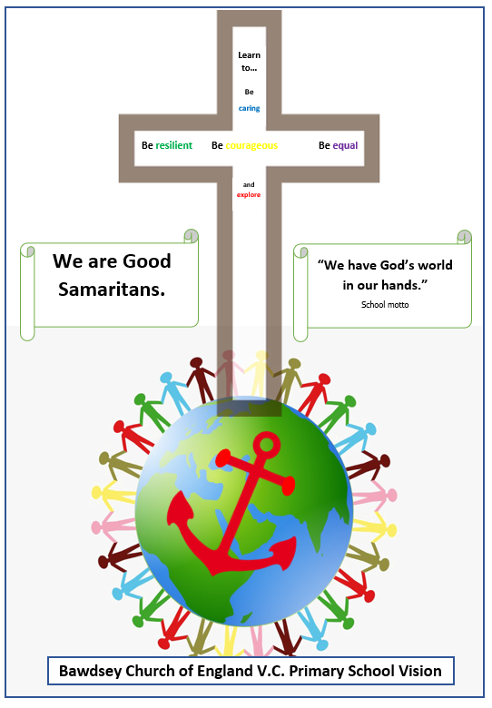
We ask the children to know the motto, parable and the four main characteristics from the vision...
Be caring
Be resilient
Be equal
Be courageous
To explore

Slide 8
Intent
Every pupil will be taught the skills and have the ability to know how to look after themselves, other people and the world and to make a positive difference with their choices.
Implementation
During their time at Bawdsey CEVCP school the children will…
Learn about themselves
Physically
Mentally
Emotionally
Spiritually
What does/ will this look like?
Platinum sports award, our aim is every child will represent the school at a sporting competition and will leave school knowing the importance of being active and with a physical activity they enjoy.
We have received our Sandwell mental health charter mark.
With PSHE, SMSC and worship we are preparing the children to be mentally and emotionally resilient. We are a Thrive school.
With RE, SMSC and worship and use of bigger questions in most subjects we are developing the pupils spiritually.

Slide 9
Learn about the world
Culturally
Historically
Geographically
Politically
Environmentally
Learn what impact they can have in the world
Personally
Interpersonally
Locally
Globally
Universally
(The implementation of our intent and school vision is also seen in the big themes throughout our curriculum.)
What does/ will this look like?
We are developing a rolling programme of other religious or cultural opportunities.
We are using timelines to help the pupils revisit and remember their past learning and inform their present learning. This transfers to the next class too.
Similarly we are plotting historical and personal events onto maps of the world.
The bigger questions in the planning is helping us address political aspects of the pupils’ learning and how this has changed history or geography.
We are supporting world charities and learning about our local environments.
The children are learning about how they can help the world and people in it.
The children are learning about historical courageous advocates.

Slide 10
Impact
The children will know how to learn effectively and how to be resilient physically, emotionally and mentally. Our aim is that Bawdsey CEVCP School pupils will explore, be strong, unique, conscientious custodians and courageous advocates of God’s world to make a positive impact with their future lives.

